Slide 1


STATISTICAL STUDY WITH PLANNING ROUTES TO AVOID SEXUAL HARASSMENT IN MEDELLÍN.

Slide 2

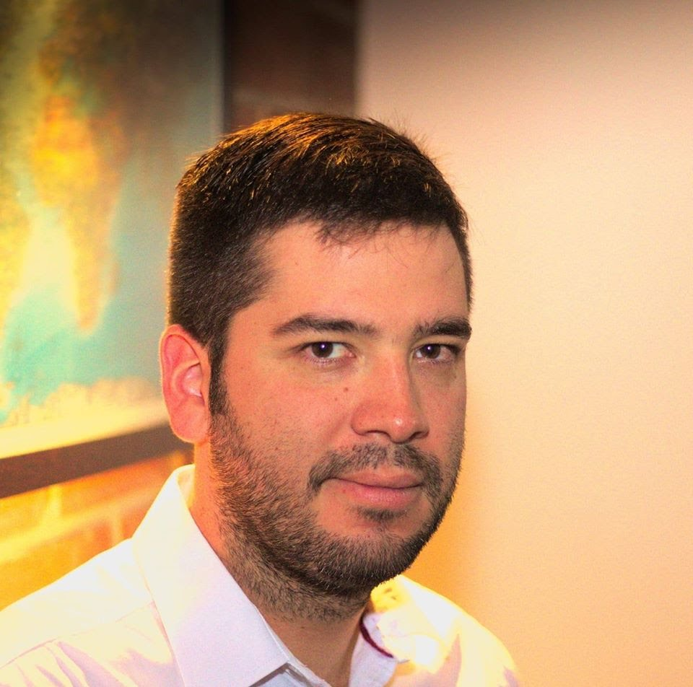
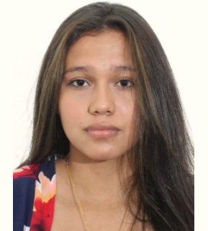
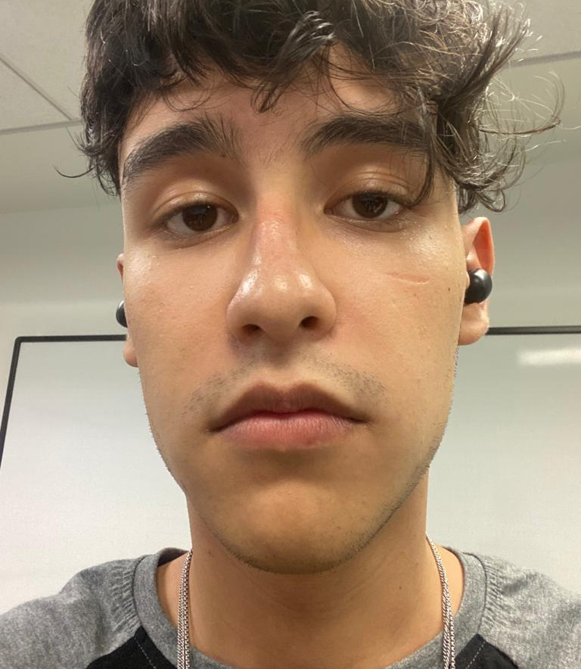


Team Presentation
Laura Danniela Zárate Guerrero.
Researcher and contributor.
Santiago Arias Higuita.
Designer and contributor.
Andrea Serna
Literature review
Mauricio
Toro
Data preparation
http://github.com/LauZar12/proyecto/

Slide 3
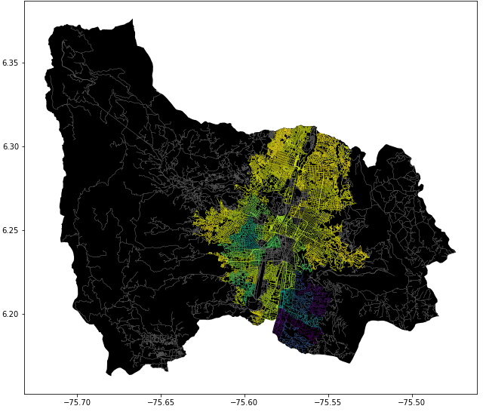
Problem Statement
Constrained Shortest Path Algorithm
Streets
of Medellín, Origin and Destination
Constrained
Shortest
Paths

Slide 4
First Algorithm
DIJKSTRA
r
Streets
of Medellín, Origin and Destination
Shortest path without exceeding a weighted-average risk of harassment r

Slide 5
Second Algorithm
DIJKSTRA
d
Streets
of Medellín, Origin and Destination
Path with the lowest weighted-average risk of harassment without exceeding a distance d

Slide 6
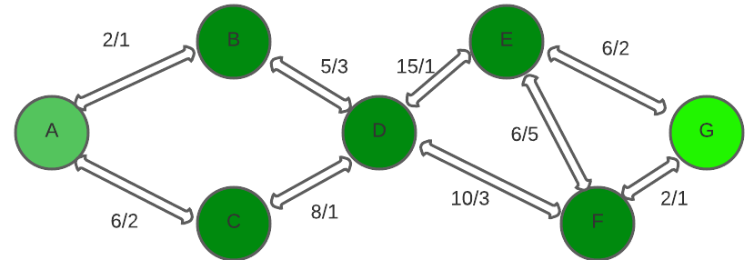

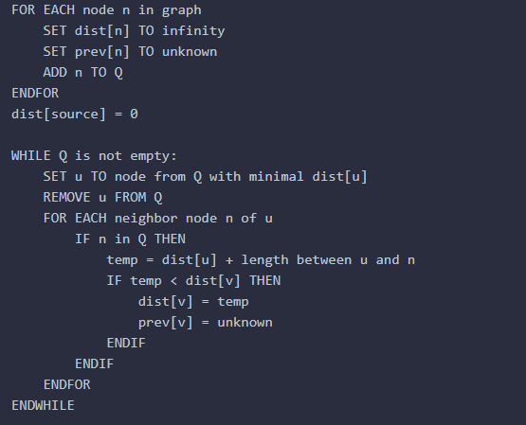
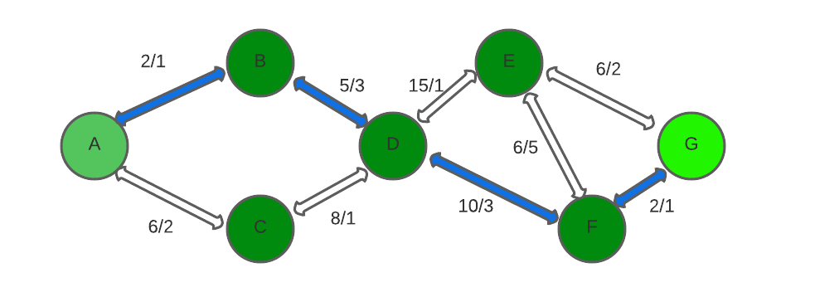
Algorithm Explanation
Fig 1
Fig 2
DIJKSTRA
Fig 3
We can observe a graph in fig1 containing two values ​​for each path from one node to another, that of the distance and that of the harassment. In fig2 we observe the operation of the Dijkstra algorithm, we can see how the algorithm search for each node the shortest path in its adjacent nodes and when it finds it, it adds them to the final path. This action is repeated until reaching the goal node. In fig 3 we can see the shortest path defined by the algorithm

Slide 7
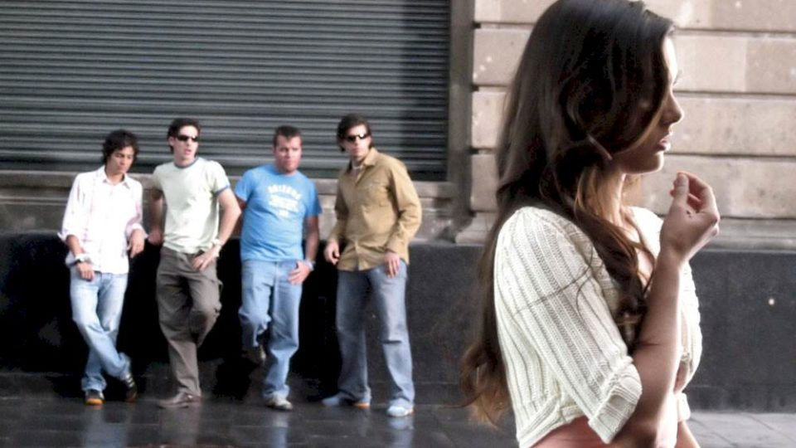
Algorithm Complexity
 | Time Complexity | Memory Complexity
DIJKSTRA WITH MODIFIED WEIGHTS | O((|V|+|E|) log |V|) | O(V²)
On the table are the time and memory complexity of the algorithms where V is the number of nodes, E is the number of edges And the memory complexity it is the one showed there because we used it for every single street (we don´t use a binary monticule or a balanced binary tree).

Slide 8
Shortest Path Results
Origin | Destination | Shortest distance (meters)
Universidad EAFIT | Universidad de Medellín | 6142m
Universidad de Antioquia | Universidad Nacional | ???
Universidad Nacional | Universidad Luis Amigó | ??
Shortest distance obtained without exceeding a weighted average risk of harassment r.
We can observe a graph in fig1 containing two values ​​for each path from one node to another, that of the distance and that of the harassment. In fig2 we observe the operation of the Dijkstra algorithm, we can see how the algorithm search for each node the shortest path in its adjacent nodes and when it finds it, it adds them to the final path. This action is repeated until reaching the goal node. In fig 3 we can see the shortest path defined by the algorithm

Slide 9
Complete this slide
For the third deliverable
Lowest Risk Results
Origin | Destination | Weighted-average risk of harassment
Universidad EAFIT | Universidad de Medellín | 0.642
Universidad de Antioquia | Universidad Nacional | 0.605
Universidad Nacional | Universidad Luis Amigó | 0.599
Lowest weighted-average risk of harassment obtained without exceeding a distance d.
We can observe a graph in fig1 containing two values ​​for each path from one node to another, that of the distance and that of the harassment. In fig2 we observe the operation of the Dijkstra algorithm, we can see how the algorithm search for each node the shortest path in its adjacent nodes and when it finds it, it adds them to the final path. This action is repeated until reaching the goal node. In fig 3 we can see the shortest path defined by the algorithm

Slide 10






Algorithm Execution Times
Execution Times
13.5 seconds
11.5 seconds
12.49 seconds
We can observe a graph in fig1 containing two values ​​for each path from one node to another, that of the distance and that of the harassment. In fig2 we observe the operation of the Dijkstra algorithm, we can see how the algorithm search for each node the shortest path in its adjacent nodes and when it finds it, it adds them to the final path. This action is repeated until reaching the goal node. In fig 3 we can see the shortest path defined by the algorithm

Slide 11

Future Work Directions
Databases
Project 1
Software Eng.
Project 2
Add other variables
A Web Application
A Web Application
Include ML or VR

Slide 12
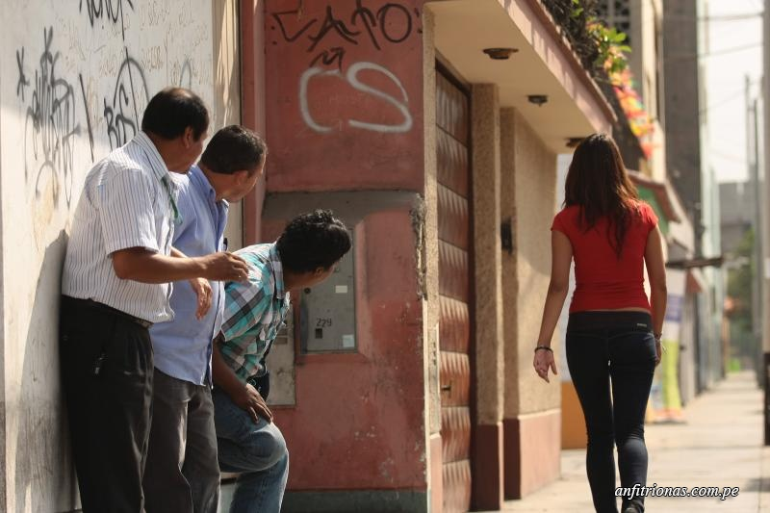
THANK YOU!.
Supported by
The first two authors were supported by mejores bachilleres grant, financed by Medellín municipality and swizz scholarship financed by swizz education foundation. All the authors would like to thank the "Vicerrectoría de Descubrimiento y Creación", of Universidad EAFIT, for their support on this research.

